Slide 1
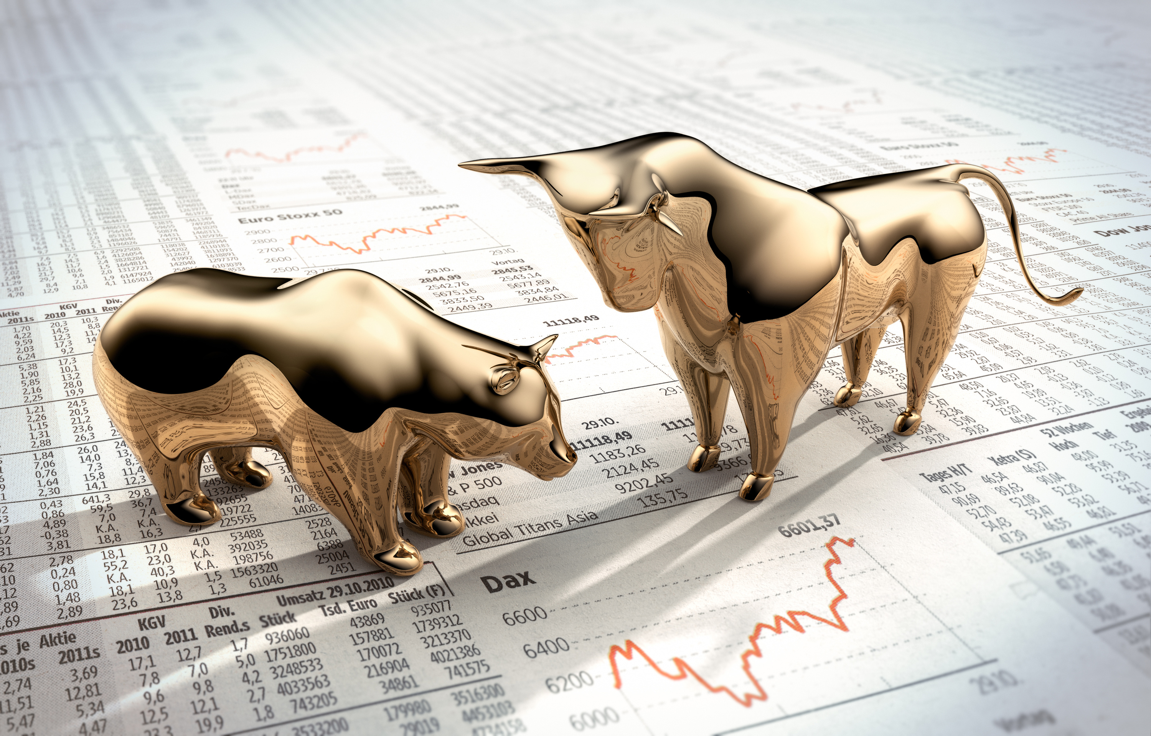

Sentiment Analysis On Stock Tweets
Project Mentor
Dr. Pradnya Khandeparkar
Group No. 8
Tanmay Desai- A006
Rohit Fuke – A010
Jayesh Khot- A027
Raj Malkar – A034
Adith Peringathara – A042

Slide 2
Introduction
Lack of income/job loss
The stock market is influenced by various factors, including investor sentiment, market sentiment, and external events.
In recent years, social media platforms, particularly Stocktwits and Twitter, have emerged as a major source of information and sentiment about stocks, with millions of tweets being posted daily.
Sentimental analysis of stock tweets involves extracting sentiment or emotions from these tweets to gain insights into investor sentiment and its potential impact on stock prices.
Unexpected expenses
Too much debt

Slide 3
Objectives
To analyse the sentiment expressed in stock-related tweets using natural language processing (NLP) techniques.
Predicting the stock prices using sentiments.
*Data taken from separate studies are attached

Slide 4





Implementing The Plan
Data Description
Conclusion
Data Preprocessing
Stock Price
Prediction
Sentiment
Analysis

Slide 5
Topic Slide
Data Description
Unexpected expenses
Too much debt

Slide 6
Variable | Type | Description
ID | String | Unique identifier for each message
Body | String | Contains the text of each message used for nlp , sentimental analysis
Created_at | Date/Time | Date and time when each message
User | String | Username of persons
Source | String | Platform or device used to post the message
Symbols | String | stock ticker symbol mentioned in the message
Owned_Symbols | String | stock ticker symbol that the user owns or has a position in
Likes | Integer | number of likes received
Mentioned_users | String | Username of other Stocktwits users mentioned in the message
Entities | String | Contains information in the form of hashtags, mentions, or other text
Links | String | embedded links
Reshare_message | String | Contains information about the message that was reshared or reposted.
Conversation | String | Contains information about the conversation, including the ID of the original post and any subsequent replies.
Reshares | Integer | the number of times the message has been reshared or reposted by other users.
*Data taken from separate studies are attached

Slide 7
Data Description
Topic Slide
What circumstances changed?
Source : https://www.data.world.com/datasets/soheiltehranipour/nvidia-tweets
This dataset contains 1056101 observations with 14 variables.
It contains tweets from 2013-2022.

Slide 8
Data Pre-processing
&#39
Dups
http://
Removing
HTML tags
Removing Duplicates
Removing URLs
Handling Special Characters and emojis
Mentions and usernames
$€£¥
🤑💰💸
@Amazon

Slide 9
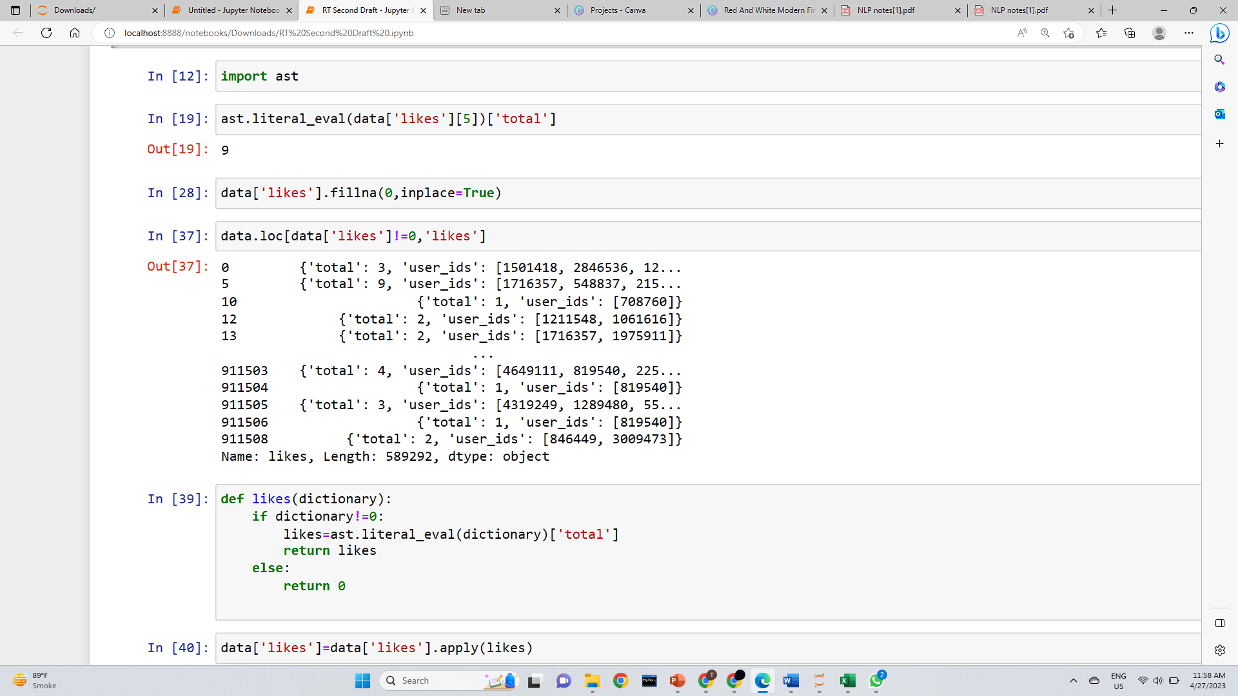
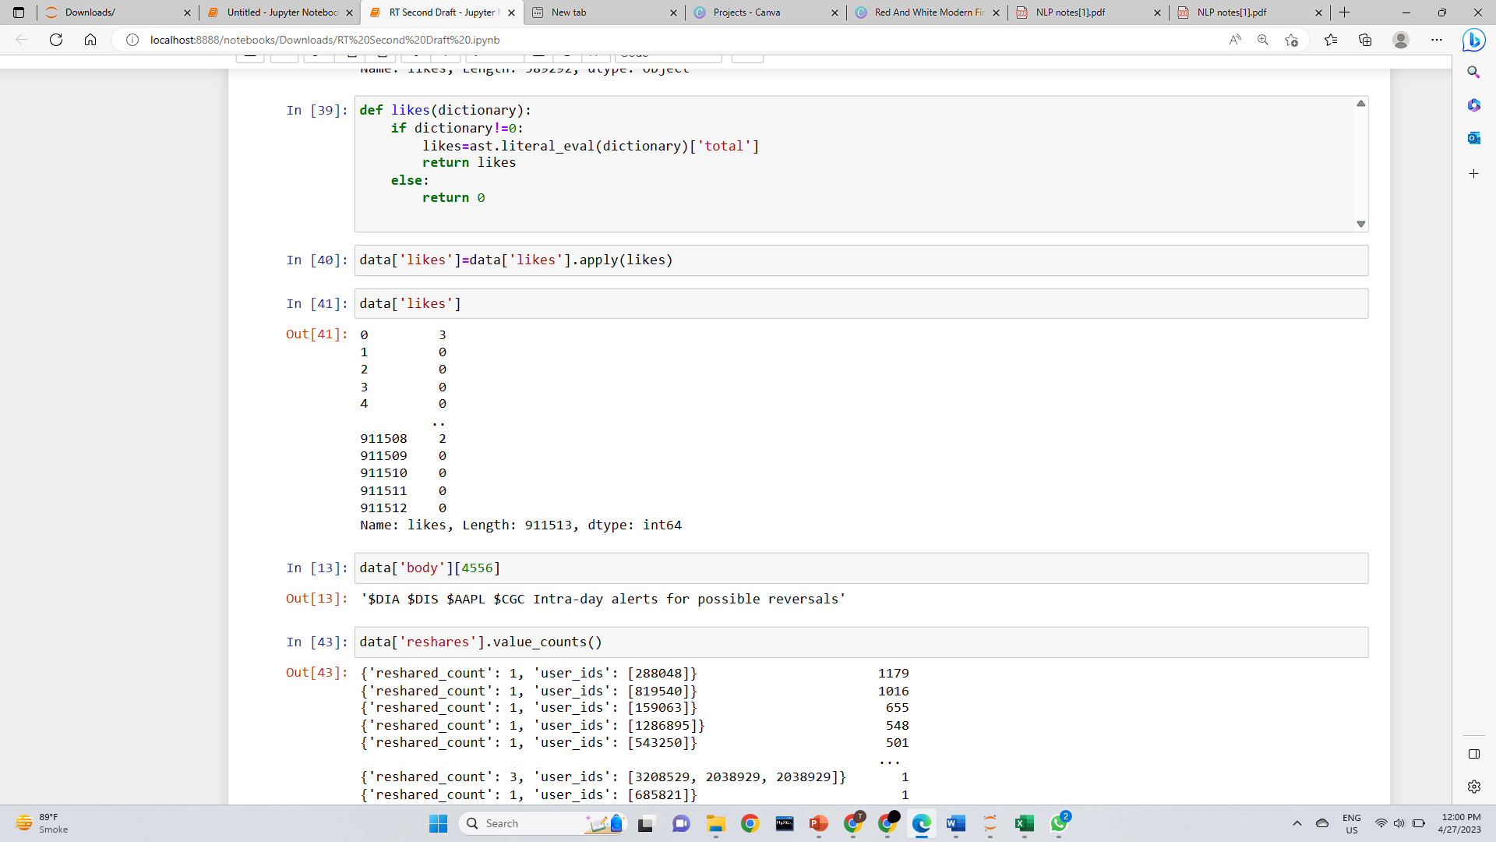
Topic Slide
Unexpected expenses
Too much debt

Slide 10
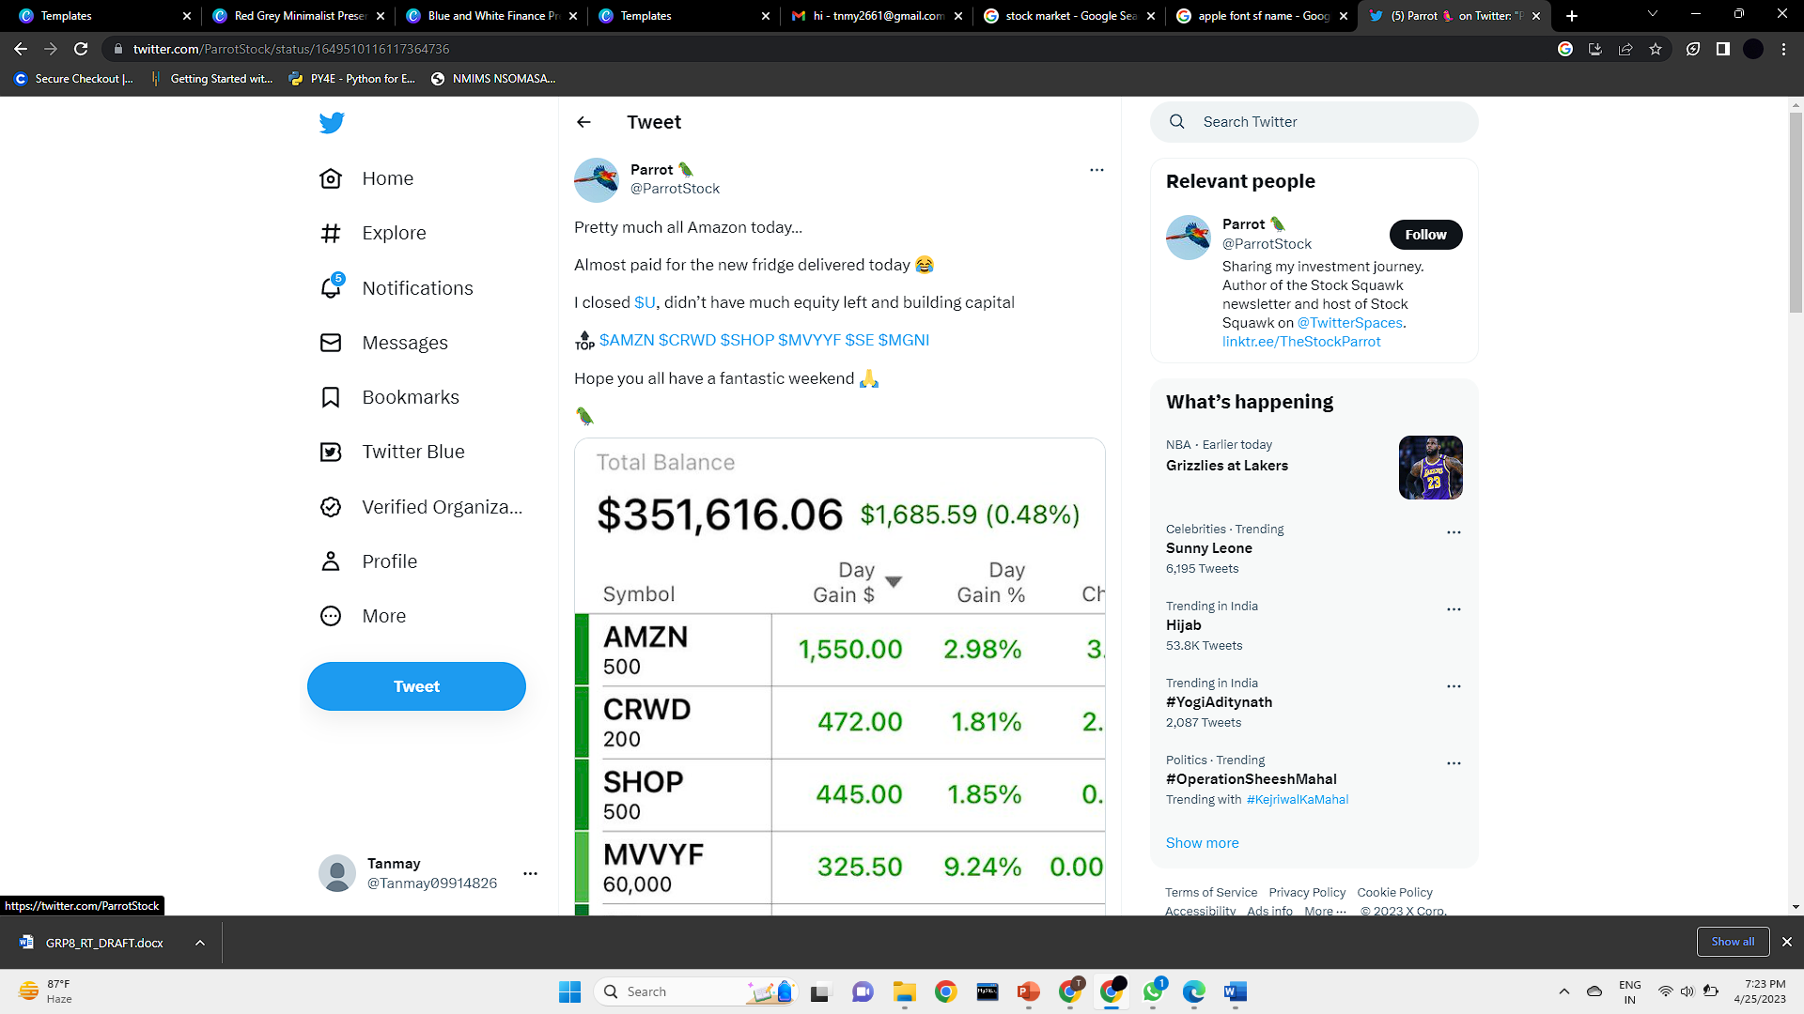
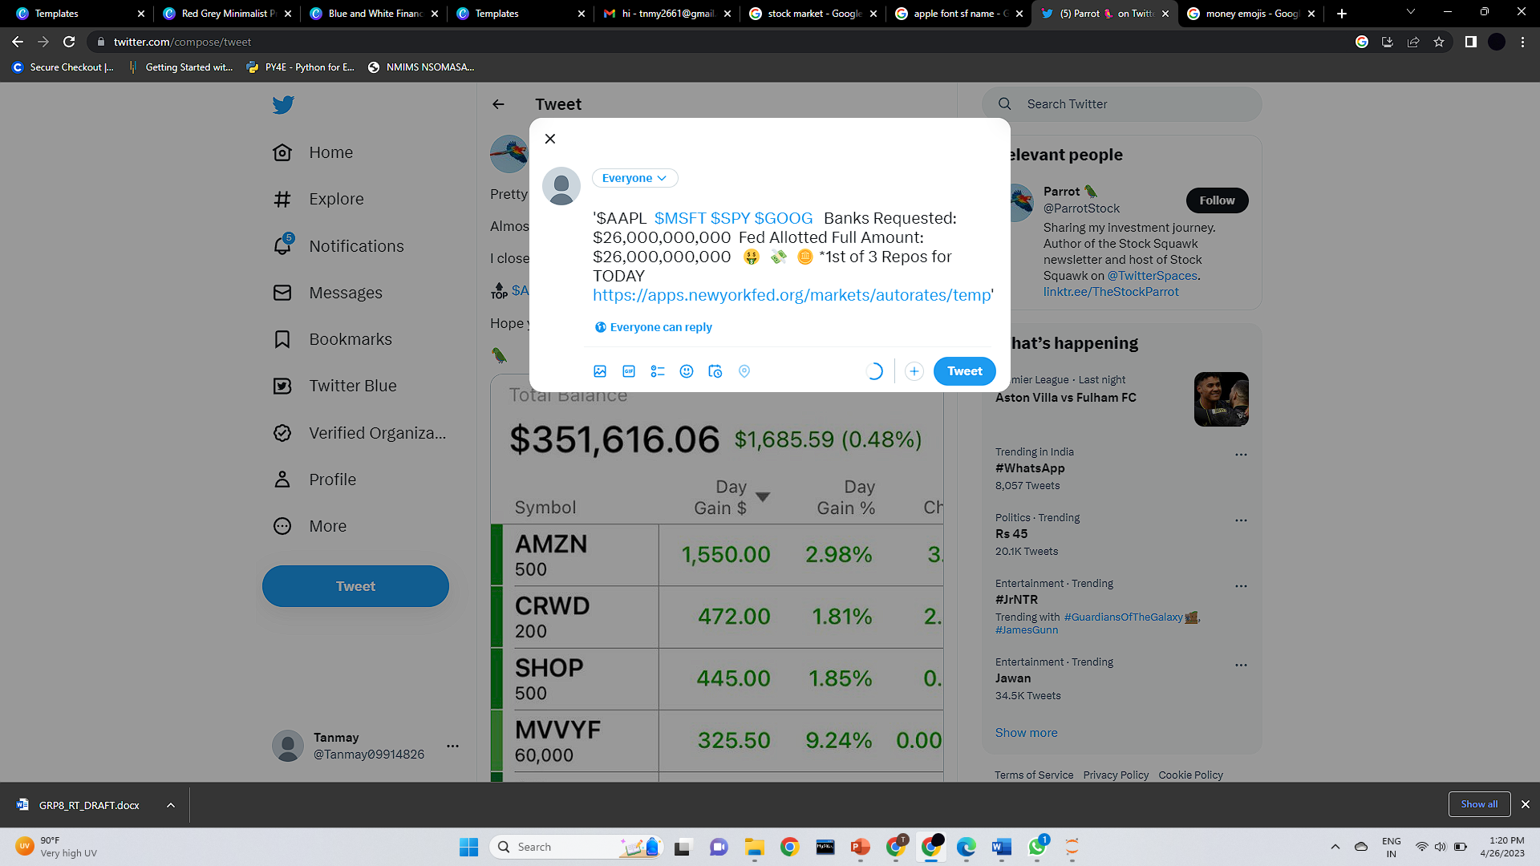
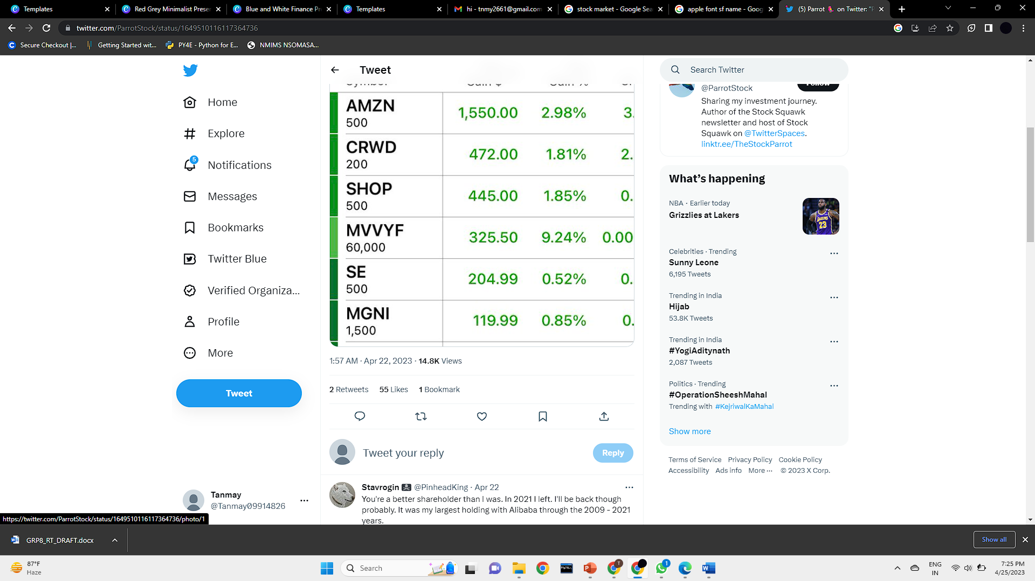
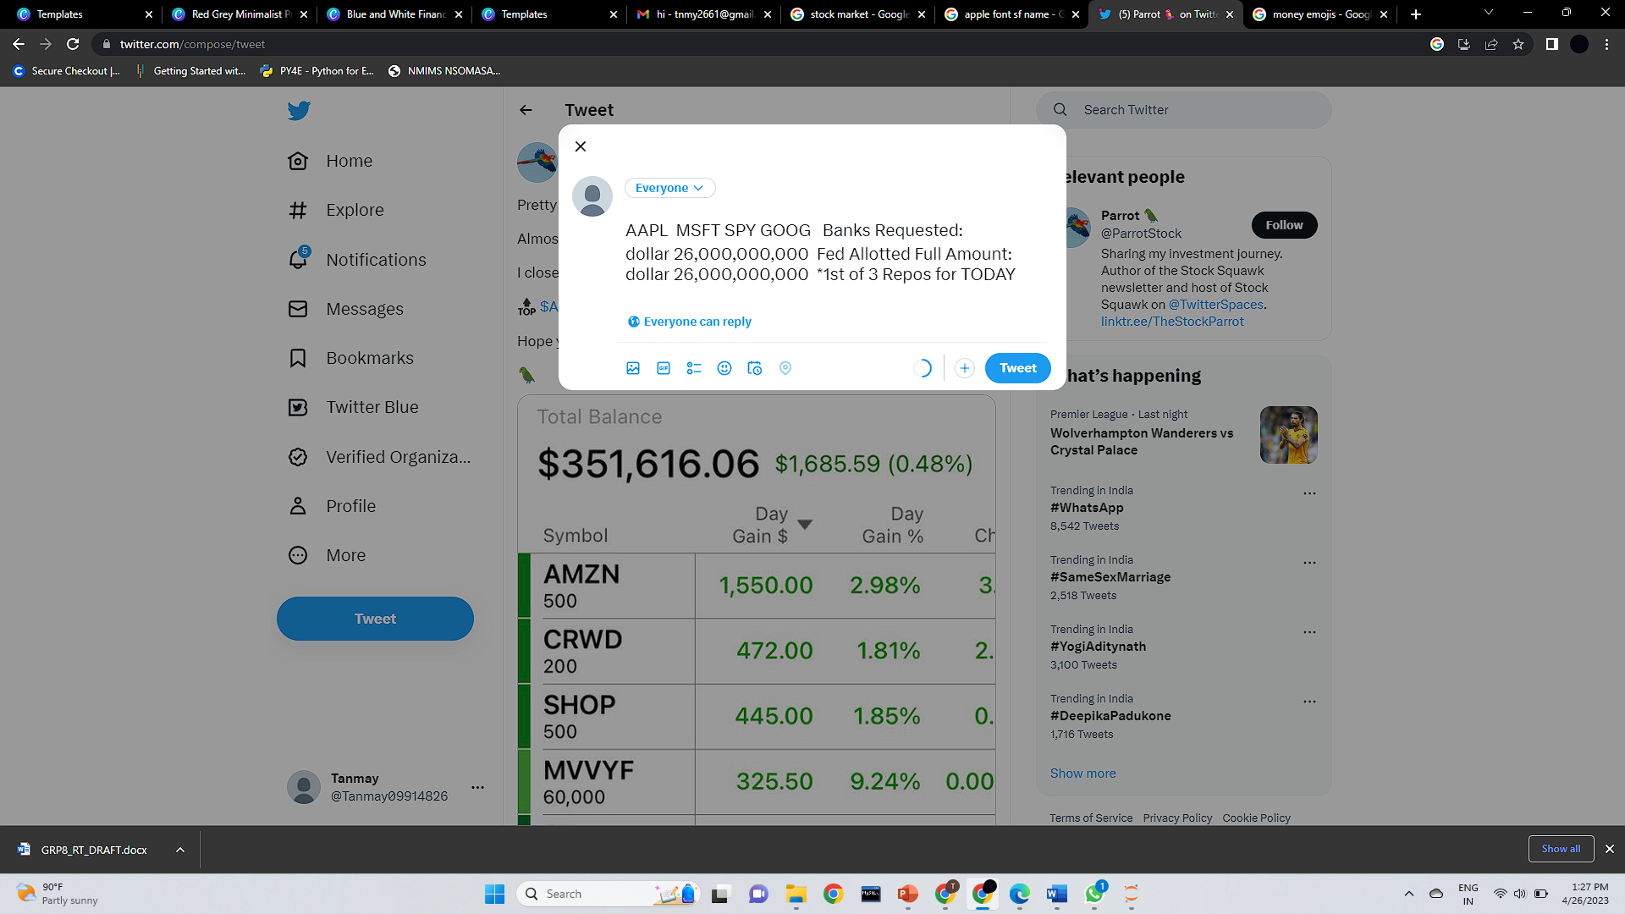
*Data taken from separate studies are attached

Slide 11
Natural Language Processing
Stop Words : Refers to commonly used words in a language. e.g. ‘the’,‘and’,‘in’ etc
Tokenization :Breaking down text into smaller units called tokens.
Lemmatization: It reduces the word to its root form and produces a valid word that has the same base meaning as original word.
What circumstances changed?
What was easy about implementing your plan?

Slide 12
Extracting the Sentiments
1.Keyword-based classification
2.VADER (Valence Aware Dictionary for Sentiment Reasoning)
3.BERT (Bidirectional Encoder Representations from Transformers)
*Data taken from separate studies are attached

Slide 13
Keyword-based classification
Keyword-based classification is a text classification technique that involves the use of specific words or phrases to classify a text document into one or more predefined categories.
Define the set of keywords : “Bullish,Upward,Strong” “Bearish,Downward,weak”
Extract keywords from the input text .
Match the keywords with the predefined set of keywords for each category.
Classify the text: After matching the keywords we can classify the text into the category that has the highest number of matched keywords.
What circumstances changed?
What was difficult about implementing your plan?

Slide 14
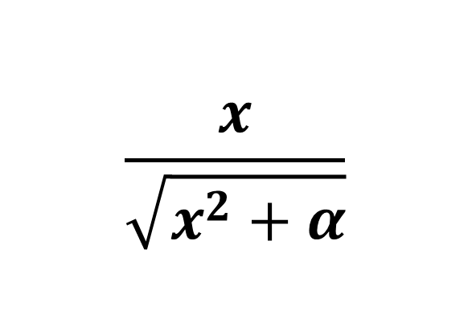
VADER(Valence Aware Dictionary for Sentiment Reasoning)
VADER sentiment analyser calculates the sentiment of a text document based on a lexicon of words and phrases that have been rated according to their valence.
What is Valence Score: It is a score assigned to the word under consideration by means of observation and experiences rather than pure logic.
Compound score =
$$\frac{x}{\sqrt{x^{2}+α}}$$
Where x is the sum of valence score
Alpha is normalizing factor with default 15.
*Data taken from separate studies are attached

Slide 15
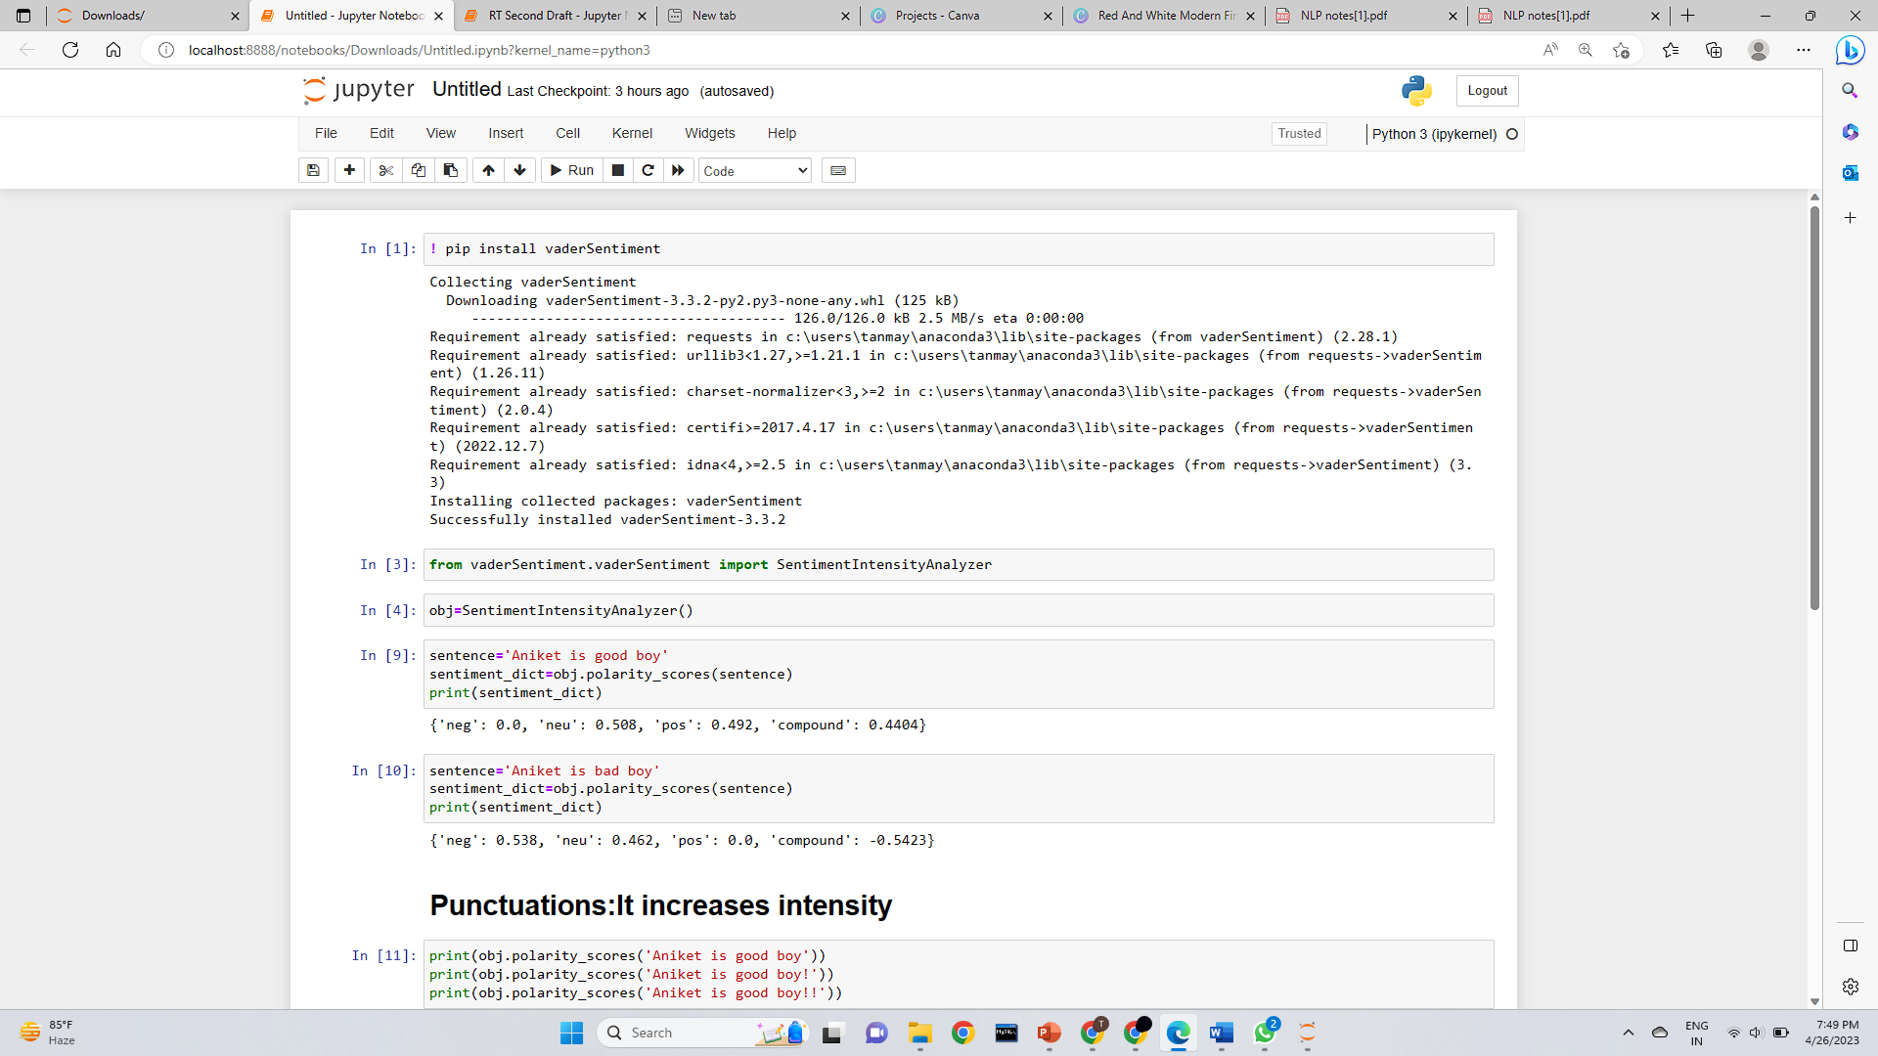
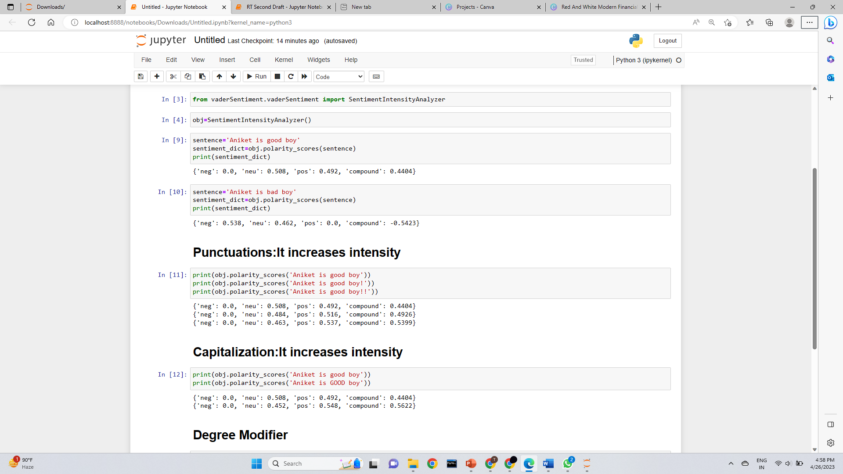
VADER(Valence Aware Dictionary for Sentiment Reasoning)
*Data taken from separate studies are attached

Slide 16
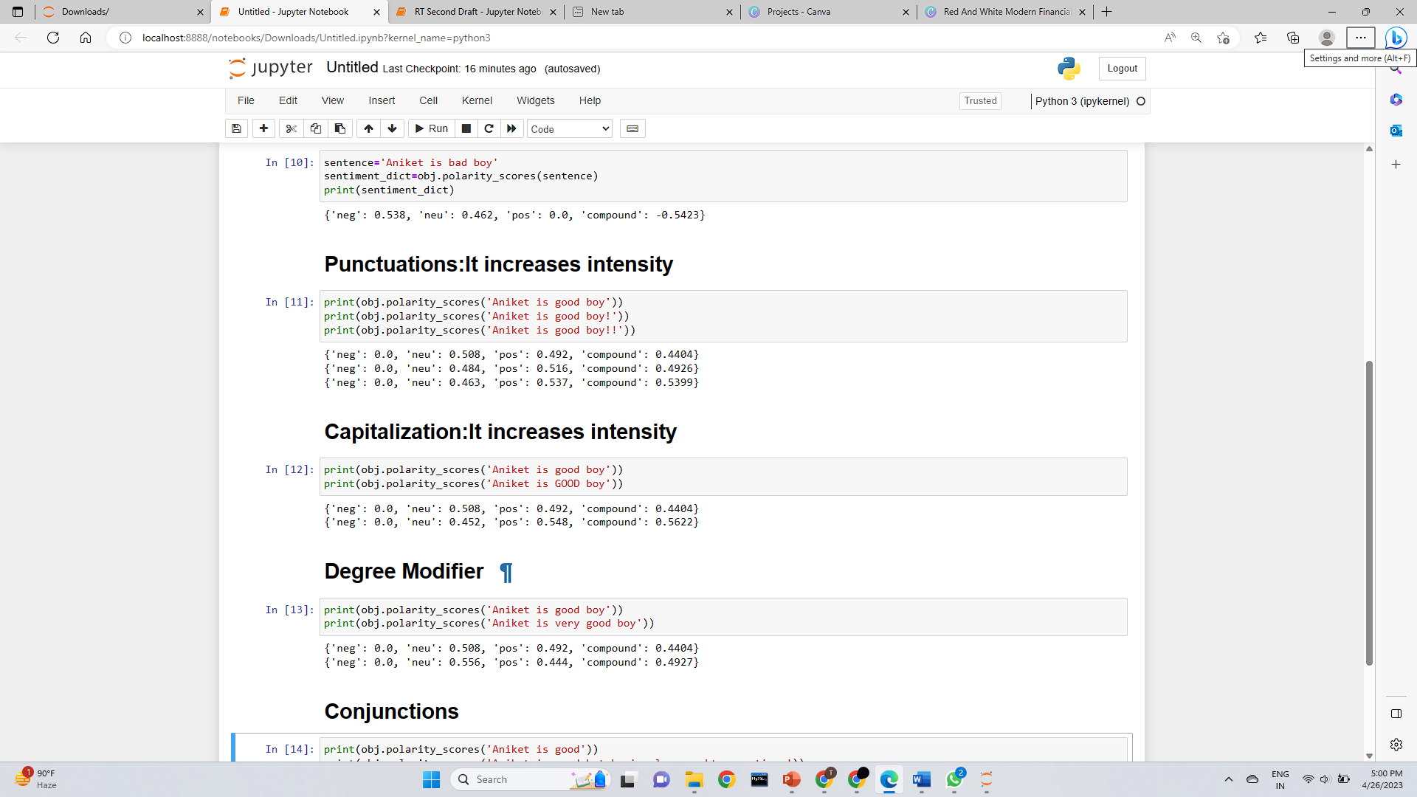
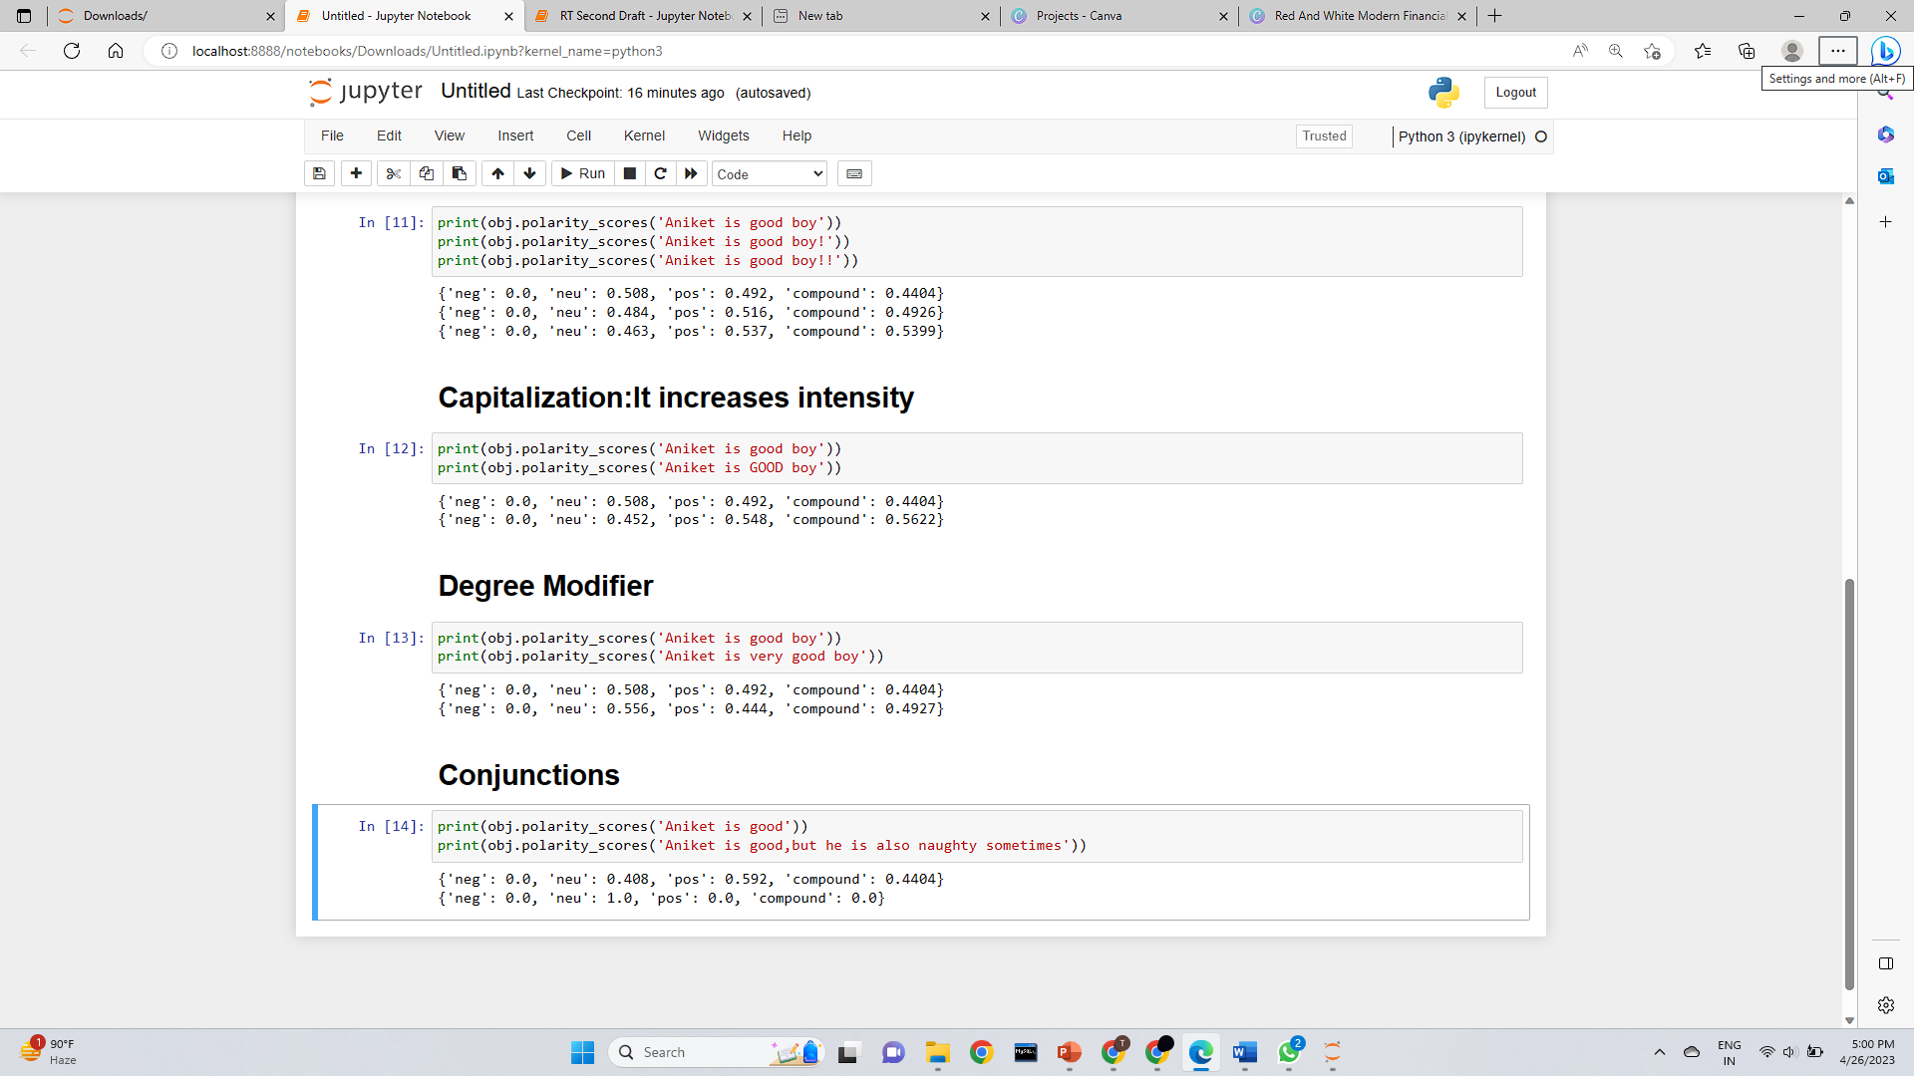
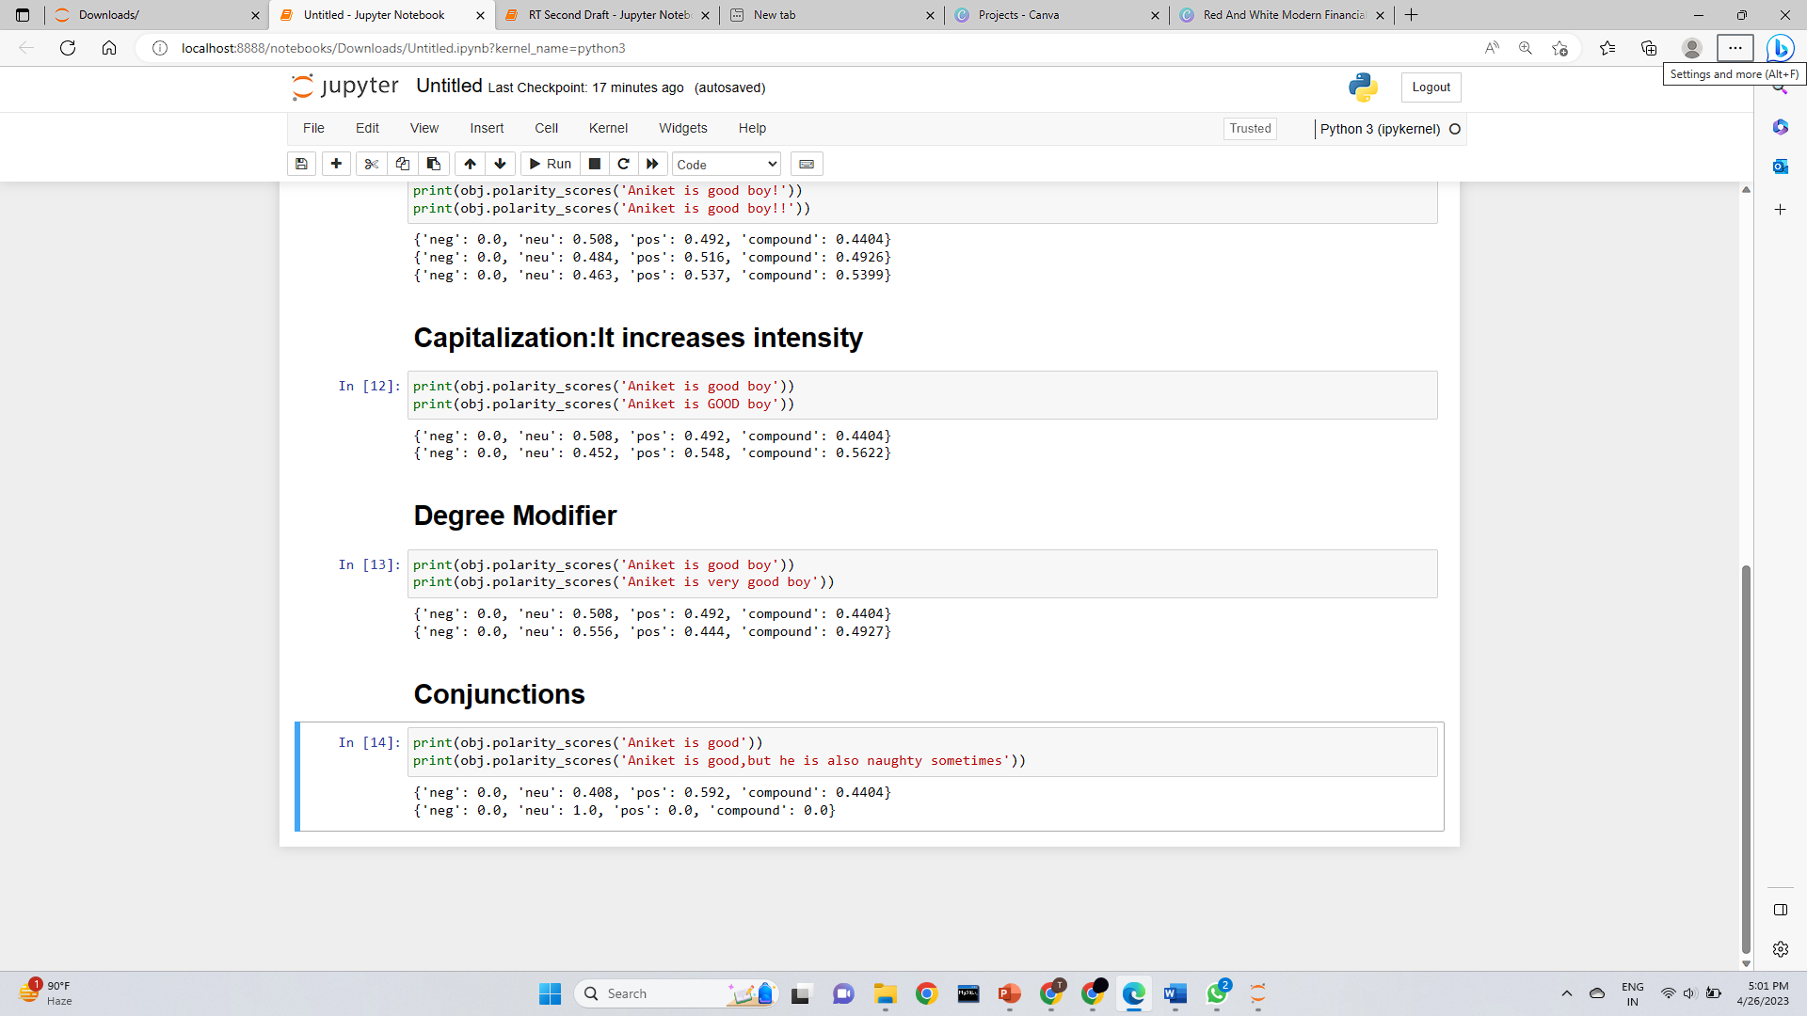
What circumstances changed?
What was easy about implementing your plan?
What was difficult about implementing your plan?

Slide 17
BERT (Bidirectional Encoder Representations from Transformers)
Pre-trained language model developed by Google in 2018.
It uses Transformer architecture to obtain a deep bidirectional representation of the input text, which has achieved state-of-the-art performance on many NLP tasks.
Transfer Learning
Huge and expensive to train
Leveraging a pre-trained model instead
*Data taken from separate studies are attached

Slide 18
BERT (Bidirectional Encoder Representations from Transformers)
“Word Embedding” = Feature Vector Representation of a word
Word Embedding Lookup Table
I like cricket.
1
2
3
4
5
6
7
8
.
.
[0.23 0.92 0.34 …… 0.65 0.12]
*Data taken from separate studies are attached

Slide 19
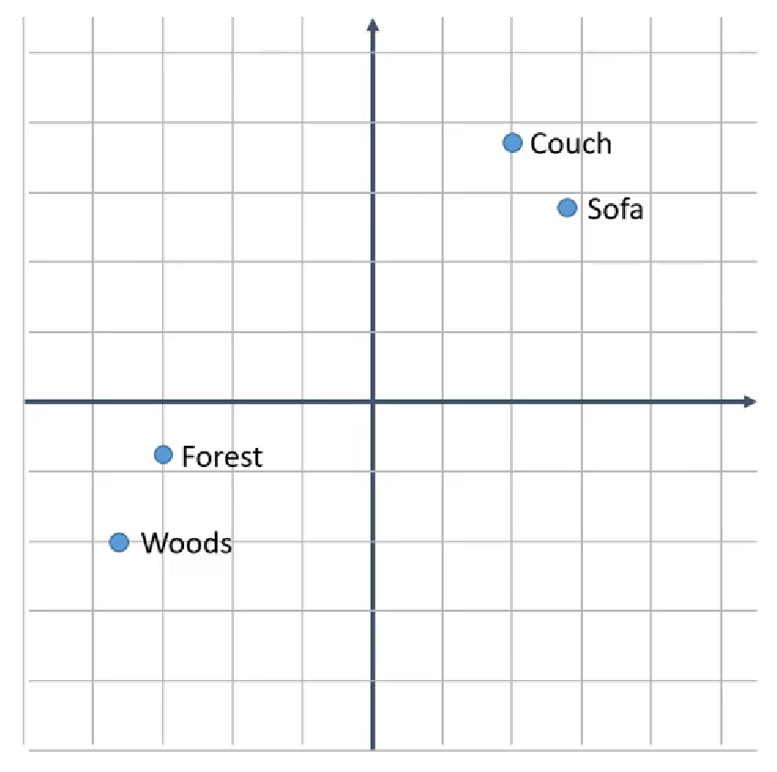
BERT (Bidirectional Encoder Representations from Transformers)
Couch and Sofa similar

Slide 20
BERT (Bidirectional Encoder Representations from Transformers)
1
0.9
0.21
0.7
He didn’t receive a fair treatment.
0
0.1
0
0.5
0.4
Fun fair in Mumbai this summer.

Slide 21
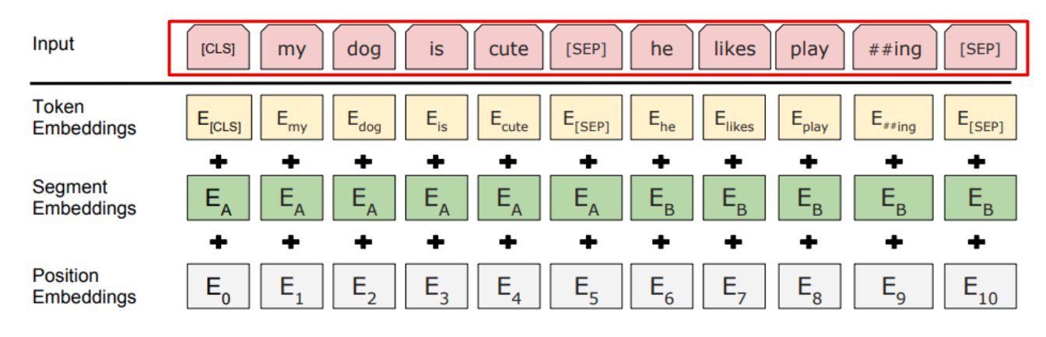
BERT (Bidirectional Encoder Representations from Transformers)

Slide 22
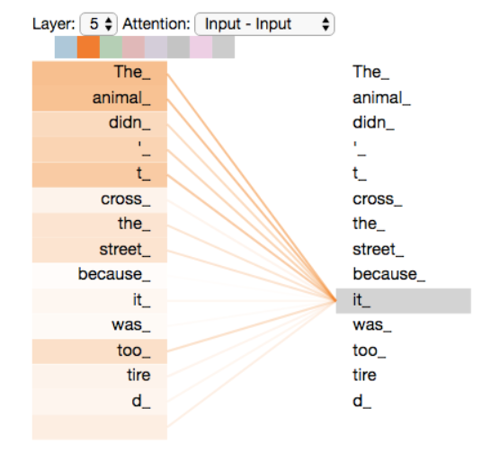
BERT (Bidirectional Encoder Representations from Transformers)
”The animal didn't cross the street because it was too tired”
What does “it” in this sentence refer to?
Is it referring to the street or to the animal?
It’s a simple question to a human, but not as simple to an algorithm.

Slide 23
Accuracy Scores on the labeled subset
Key-Word Based Classification | VADER | BERT
27% | 63.7% | 81.85%

Slide 24
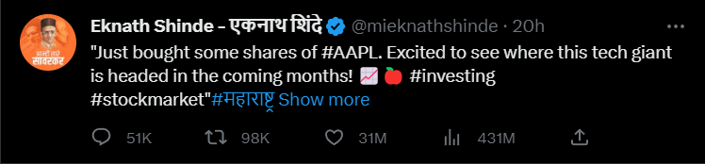
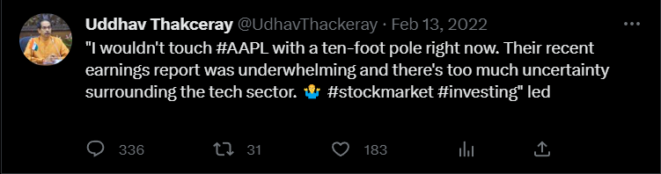
Giving more influential tweets more weight
Greater Weights
Lower Weights

Slide 25
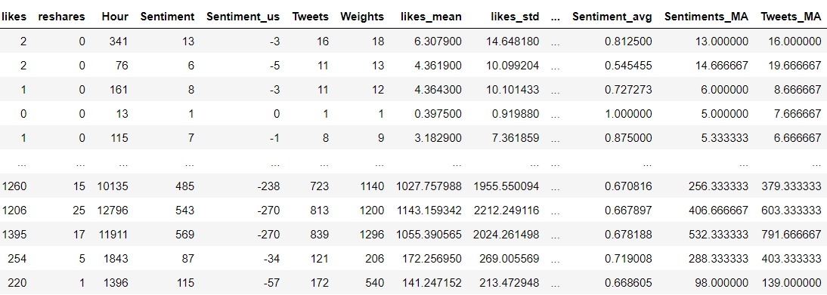
Data with Sentiments

Slide 26
LSTM(Long Short-Term Memory)
Why LSTM?
Traditional RNNs have difficulty in capturing long-term dependencies
Handles long term dependencies and memory
Captures complex relationships between different time series
Ability to store information over a long period of time
LSTMs can be trained faster than traditional RNN
*Data taken from separate studies are attached

Slide 27
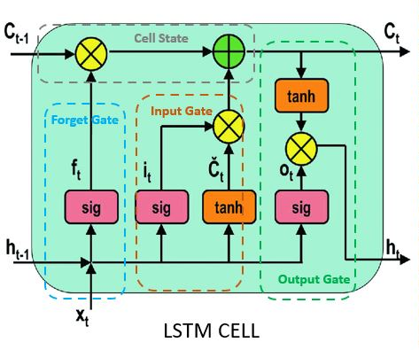
LSTM(Long Short-Term Memory)
What circumstances changed?
What was easy about implementing your plan?
What was difficult about implementing your plan?

Slide 28
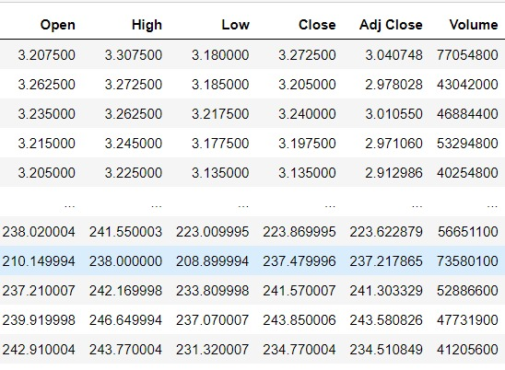
Stock Data
What circumstances changed?
What was difficult about implementing your plan?

Slide 29
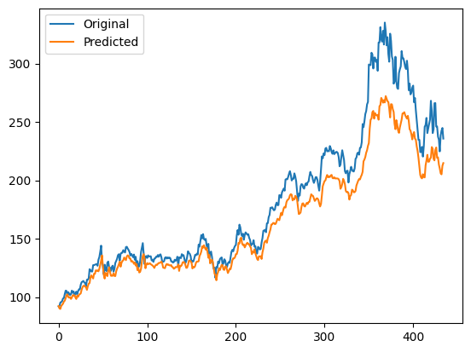
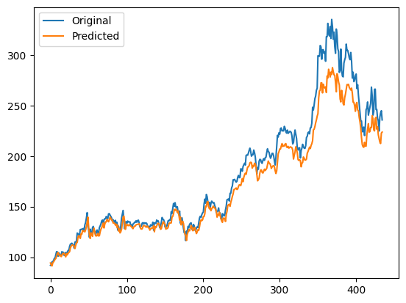
LSTM(Long Short-Term Memory)
What circumstances changed?
What was difficult about implementing your plan?
Without Sentiment
RMSE=17.13525
With Sentiment
RMSE=15.18358

Slide 30
Conclusion
BERT has highest accuracy and performs significantly better than keyword based classification and VADER.
LSTM model with sentiment is marginally a better fit compared to without sentiment.
*Data taken from separate studies are attached

Slide 31
Limitations
Topic Slide
Limited data: Sentiment analysis algorithms require large amounts of data to train and operate effectively. However, there may be a limited amount of relevant data available, especially for smaller or less well-known companies.
Noise: Stock tweets often contain noise such as spam, irrelevant content, and misleading information. This can affect the accuracy of sentiment analysis algorithms and lead to incorrect stock price predictions.
Market unpredictability: Stock prices are affected by many unpredictable factors, such as changes in government policies, natural disasters, and unexpected news events.
What went right? What went wrong?
What circumstances changed?
Was there anything you didn't account for?
What was easy about implementing your plan?
What was difficult about implementing your plan?

Slide 32
Future Scope
Analyze sentiment for other companies: You could apply the same sentiment analysis techniques used for NVDIA to other companies on Stocktwits
Develop a real-time sentiment tracker: create a system that continuously scrapes Stocktwits for sentiment data and updates stock price predictions in real-time.
Incorporate additional data sources: explore other data sources, such as news articles or financial reports, to improve the accuracy of your stock price predictions.
Attention model can be used.
What circumstances changed?
What was easy about implementing your plan?
What was difficult about implementing your plan?

Slide 33
References
Research Paper
Stock Emotions and Financial Analysis and Time series analysis
BERT
https://jalammar.github.io/illustrated-transformer/
https://youtu.be/zJW57aCBCTk?list=PLam9sigHPGwOBuH4_4fr-XvDbe5uneaf6
VADER
https://medium.com/@mystery0116/nlp-how-does-nltk-vader-calculate-sentiment-6c32d0f5046b
https://blog.quantinsti.com/vader-sentiment/
LSTM
https://www.analyticsvidhya.com/blog/2022/03/an-overview-on-long-short-term-memory-lstm/
*Data taken from separate studies are attached

Slide 34
Topic Slide
Evaluating The Plan
Was your problem solved? Did a new problem arise?
Thank You!
What went right? What went wrong?
What circumstances changed?
Was there anything you didn't account for?
What was easy about implementing your plan?
What was difficult about implementing your plan?

